Slide 1
Group 4
Jan & Joachim

Slide 2
Pre-Processing Pipeline
Data exploration (i.e. head(), columns…)
Pre-tokenization cleanup
Tokenization
WordNet Lemmatization (w/ NLTK)
Used wordnet_pos to narrow the results
TF-IDF vectorization applied to Word2Vec embedding
Applied the embeddings to the IDF weights to improve accuracy
Scaled the embeddings with Standard Scaler
=> applied to TRAIN + TEST sets individually

Slide 3
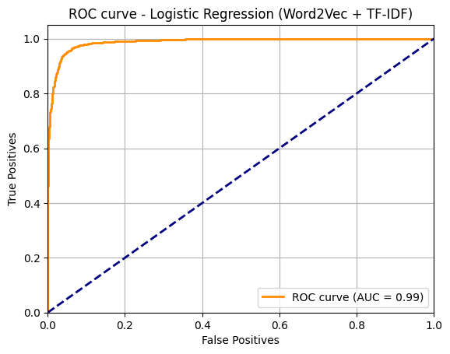
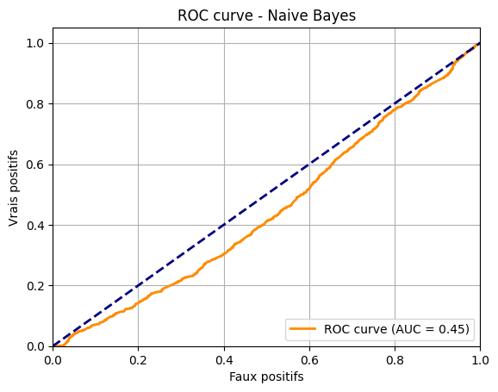
Model
Logistic Regression
Best parameters: max_iter=1000 & random_state=42
Accuracy score = 95.24 %
Other models:
SVM : Accuracy score = 90.51 %
Naive Bayes : Accuray score = 50.90 %
VS

Slide 4
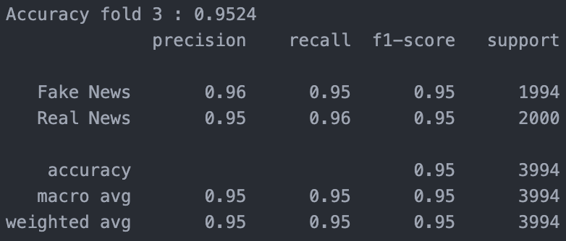
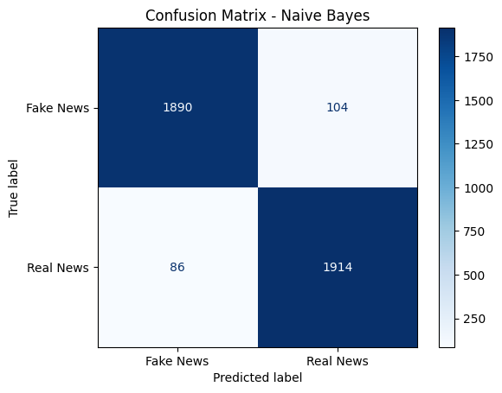
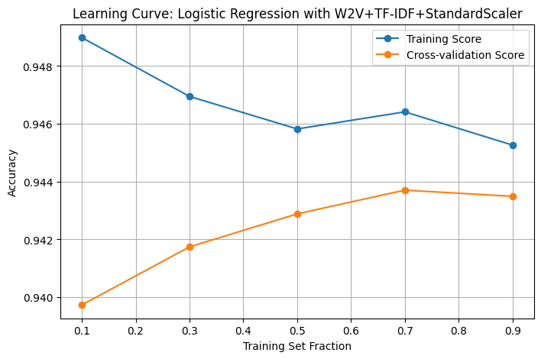
Results

Slide 5
Discussion
Best things :
Understood train-test split / pre-processing / training sequence
Applied / cross-validate different models
Better project management as a group
Not sure which learning curve is better : ours or our models’ ? 🤔
Worst regrets in this project :
That it’s over !
We want more DATAAA !

